Slide 1

IBM HR Data Analysis Project
Somya Jain (MABSPG23042)
Bharti (MABSPG23012)
Vansh Singla (MABSPG23004)
Nikunj Gupta (MABSPG23030)
Yashvinder Shokeen (MABSPG23048)

Slide 2

Data Collection and Loading
1
Data Source
2
Data Format
The IBM HR data set was obtained from Kaggle, a popular platform for data science and resources.
The data was provided in a CSV file format, containing information about employee attributes, performance, and demographics.
3
Loading Process
4
Data Integrity
We utilized SQL commands to load the data into a MySQL database for efficient querying and analysis.
We ensured data integrity by validating the data for inconsistencies and missing values during the loading process.

Slide 3

Data Cleaning and Transformation
Handling Missing Values
Data Type Conversions
Data Normalization
We addressed missing values by using different techniques based on statistical measures and domain knowledge.
We converted data types to ensure consistency and optimize data storage, aligning with SQL data type standards.
We normalized the data to reduce redundancy and improve data integrity, enhancing query efficiency.

Slide 4

Data Storage and Management
MySQL Database
Database Design
We chose MySQL as our database system due to its robust features, scalability, and strong support for SQL queries.
We designed our database schema to effectively represent the data structure and relationships between entities.
Data Security
Backup and Recovery
We implemented security measures to protect the data ensuring data confidentiality and integrity.
We established regular backup and recovery procedures to ensure data availability and minimize data loss in case of failures.

Slide 5

Data Analysis and Insights
1
Attrition Prediction
Attrition: Indicates whether the employee left the company (Yes/No). This is your dependent variable or target for analysis.
2
Job Role
Indicates the specific position held by the employee.
3
Monthly Income
Represents the financial compensation, which could affect attrition.
4
Overtime
Indicates whether the employee works overtime (Yes/No), which can be a contributing factor to attrition

Slide 6
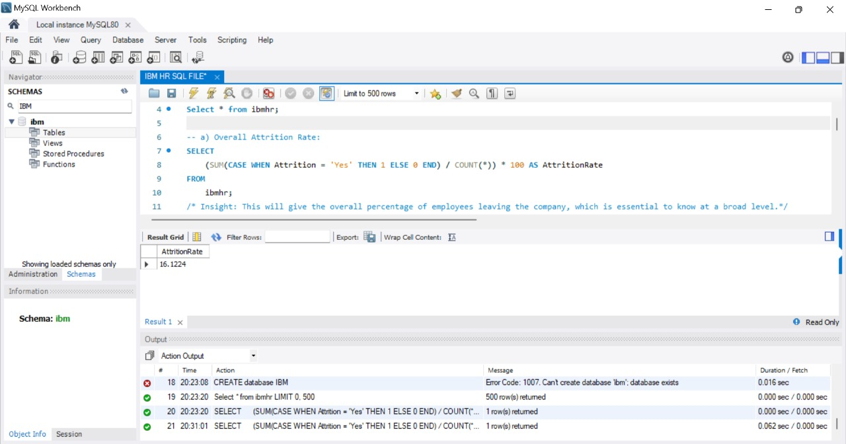
SQL Codes
Overall Attrition Rate:
CREATE database IBM;
Use IBM:
Select * from ibmhr;
Overall Attrition Rate:
SELECT
(SUM(CASE WHEN Attrition = 'Yes' THEN 1 ELSE 0 END) / COUNT(*)) * 100 AS AttritionRate
FROM
ibmhr;
* Insight: This will give the overall percentage of employees leaving the company, which is essential to know at a broad level.*
An overall attrition rate of 16.12%
This suggests that approximately one in six employees are leaving the company.
If the attrition rate is higher than the industry benchmark, it could indicate issues with employee retention that need addressing.

Slide 7
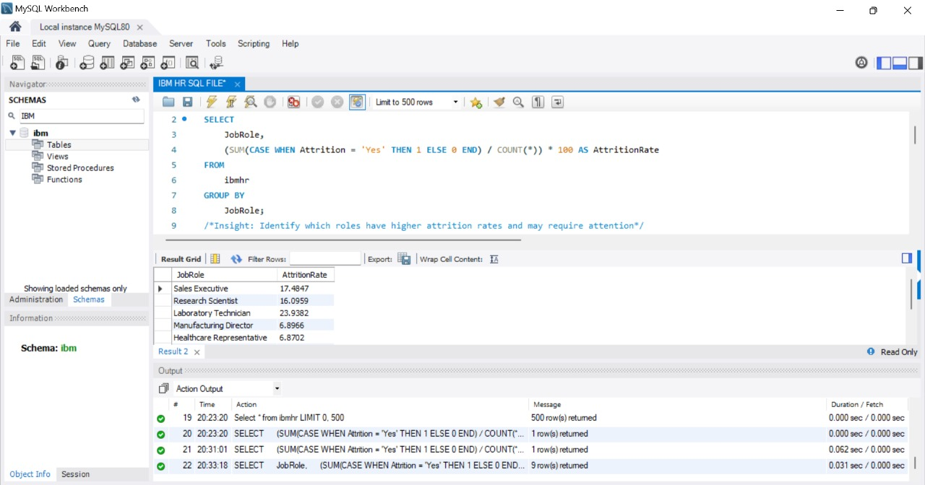
Attrition by Job Role:
SELECT
JobRole,
(SUM(CASE WHEN Attrition = 'Yes' THEN 1 ELSE 0 END) / COUNT(*)) * 100 AS AttritionRate
FROM
Ibmhr
GROUP BY
JobRole;
*Insight: Identify which roles have higher attrition rates and may require attention*
High attrition roles like Sales Representatives (39.76%) and Laboratory Technicians (23.94%) suggest a need to address factors like compensation, work conditions, and support. Mid-range roles such as Research Scientists (16.10%) may require monitoring, while low attrition roles like Research Directors (2.50%) and Managers (4.90%) indicate stability and effective retention strategies.

Slide 8
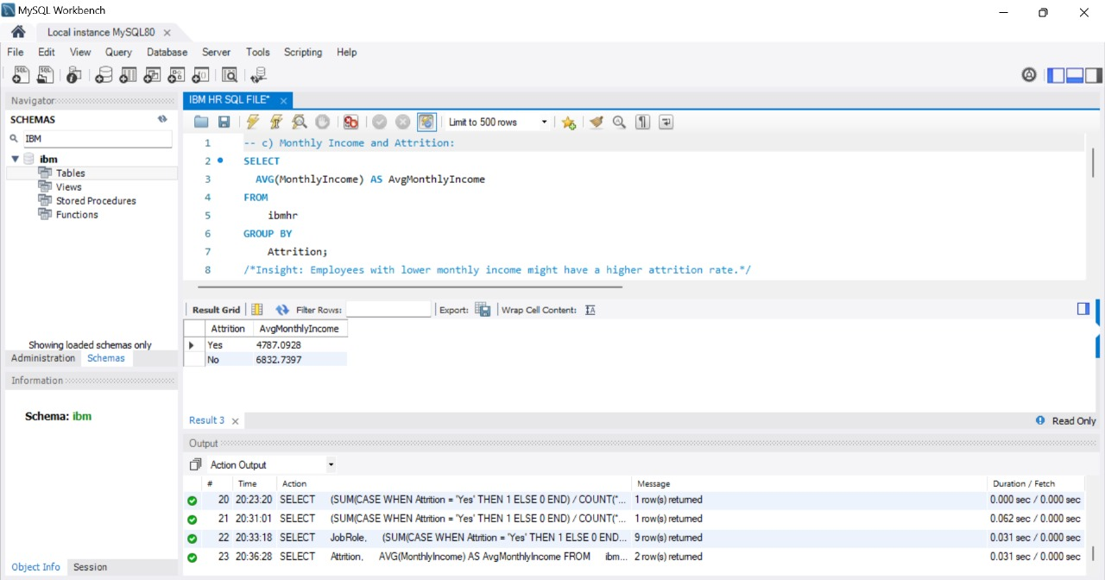
Monthly Income and Attrition:
SELECT
Attrition,
AVG(MonthlyIncome) AS AvgMonthlyIncome
FROM
Ibmhr
GROUP BY
Attrition;
*Insight: Employees with lower monthly income might have a higher attrition rate.*
Lower income correlates with higher attrition, as employees who left earned an average of $4,787.09, compared to $6,832.74 for those who stayed. This suggests compensation plays a key role in turnover, and re-evaluating salary packages or offering incentives could improve retention.

Slide 9
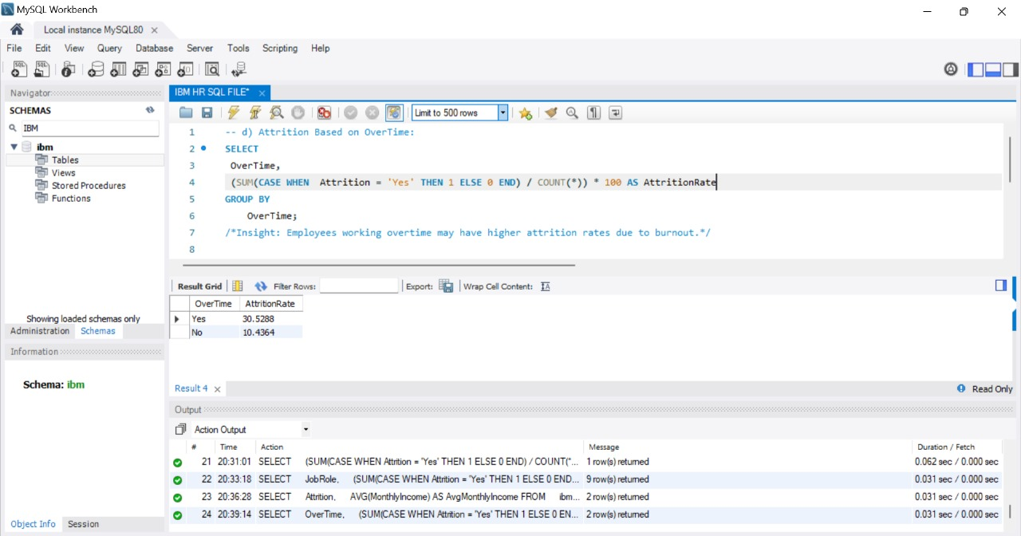
Attrition based on Overtime:
SELECT
OverTime,
(SUM(CASE WHEN Attrition = 'Yes' THEN 1 ELSE 0 END) / COUNT(*)) * 100 AS AttritionRate
FROM
Ibmhr
GROUP BY
OverTime;
*Insight: Employees working overtime may have higher attrition rates due to burnout.*
Employees who work overtime face a higher attrition rate (30.53%), likely due to burnout or work-life balance issues. In contrast, those without overtime have a lower attrition rate (10.44%), suggesting better satisfaction and retention.

Slide 10
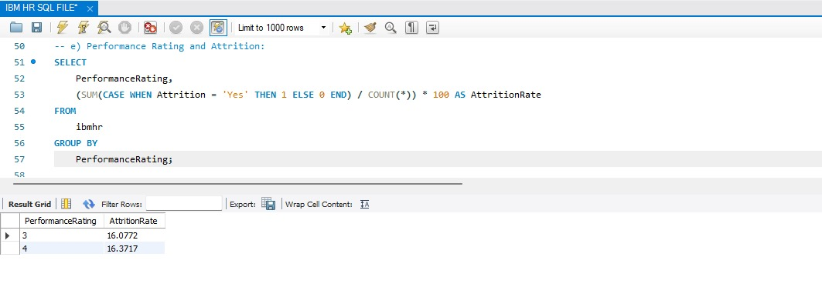
Performance Rating and Attrition
SELECT
PerformanceRating,
(SUM(CASE WHEN Attrition = 'Yes' THEN 1 ELSE 0 END) / COUNT(*)) * 100 AS AttritionRate
FROM
Ibmhr
GROUP BY
PerformanceRating;
*Insight: Performance impacts attrition, which can suggest that high-performers or low-performers are more likely to leave.*
There is minimal difference in attrition between employees with a performance rating of 3 (16.08%) and 4 (16.37%), indicating that performance ratings have little impact on turnover. High performers may still leave due to factors like limited growth opportunities, work-life balance, or better offers elsewhere.

Slide 11




Conclusion and Recommendations
Key Findings
Future Directions
Recommendations
Based on the findings, we recommend Revise pay structures and introduce flexible working hours and improve work-life balance. Enhance job satisfaction and retention with career development programs.
The analysis revealed valuable insights into employee performance, attrition drivers, and income.
Further exploration of the data can lead to more advanced analytics, predictive modeling, and data-driven decision making.

Slide 12


